Slide 1
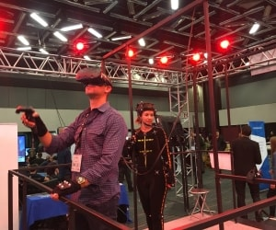
Virtual Reality in Research and Industry
Notes:
Hello everyone, my name is Danlu, I am an ESRC post-doctoral fellow. I use virtual reality for my studies and currently I am doing a placement at a company in the VR industry called Vicon. Today I would like to share my experience with VR with you.

Slide 2
Virtual Reality
Notes:
What is virtual reality?
Usually, it involves a three-dimensional image or environment generated and simulated by computer. This environment can be interacted with in a seemingly real way by a person. For example, the person can walk in this environment, kick a ball in the environment, etc. Special electronic equipment is need, for example a helmet with a screen inside, such as Oculus Rift and HTC Vive. Probably you have heard a lot about them.

Slide 3
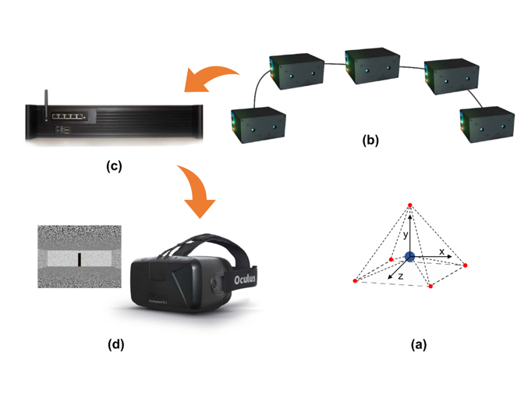
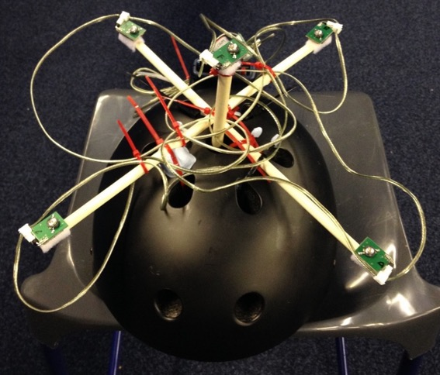
Virtual Reality
Notes:
Sometimes, sensors will be placed on the person so that a motion capture system can track the movement of the person and reflect it in the display shown on the headset screen. In our lab, we used LED trackers and placed them on a helmet so that we could track the position and orientation of the participant’s head. In addition, same trackers were placed on their shoulders.

Slide 4
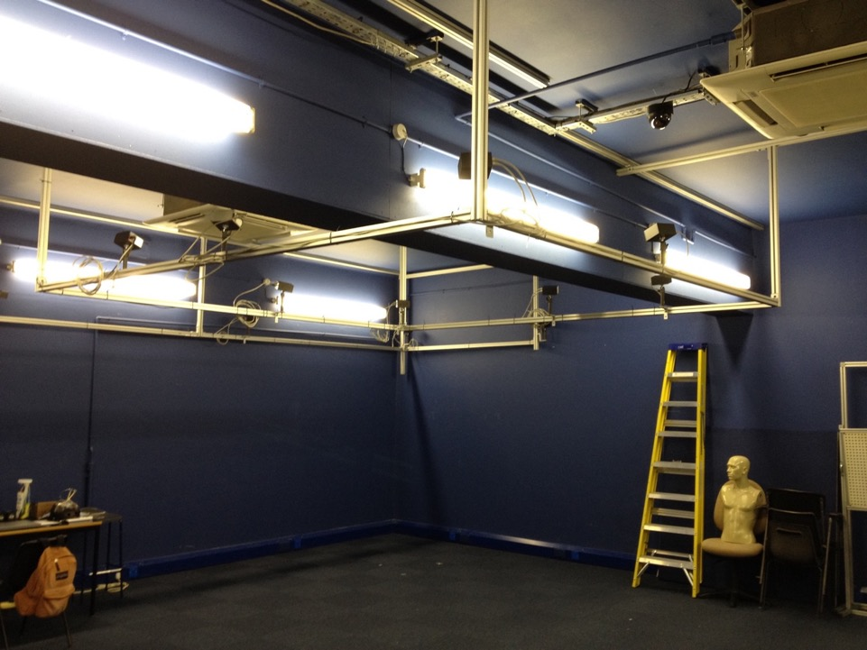
Notes:
To capture the signal sent from the trackers, we had a motion capture system that consists of 16 cameras. The cameras were placed in a way to maximize the volume that any trackers could be reliably tracked. This also determines the space that our participants could move freely in the virtual world. Outside the volume, the signal would be unreliable, and the system would lost the signals of the participant’s movement.
The signal captured by the motion tracking system will be processed by a server and then reflected on the display shown on the head screen.

Slide 5
Virtual Reality
Notes:
So put it together, the trackers defines the participant’s head (or shoulder) as a rigid body.
The position and orientation of the rigid body is captured by the motion-tracking system.
The information is processed by a server and then sent to the headset and reflected in the simulation of the movement in the virtual scene.

Slide 6
Study Visual Guidance of Walking in VR
Notes:
How virtual reality technology helped me address my research questions?
In my PhD. I studied perception and action, specifically, how people use visual information to guide their walking to a target. Virtual reality had shown itself to be a great tool to study the topic. Let’s see how it works, starting from an example….

Slide 7
Classic Theories
Optic Flow Hypothesis
  James Gibson (1940s)
Notes:
One theory, proposed by Gibson during the second world war, suggests that we optic flow. When we walk forward, the relative motion of the scene will form an EXPANDING radial pattern AT THE EYE, like this. This is optic flow, and the focus of expansion indicates the current direction of our walking, or heading. This theory suggests that one could steer to a goal by keeping the focus of expansion ALIGNED WITH THE TARGET.
For video see https://cardiff.cloud.panopto.eu/Panopto/Pages/Viewer.aspx?id=791cdf7b-4dbd-465d-8a67-aa4d00a7a786

Slide 8
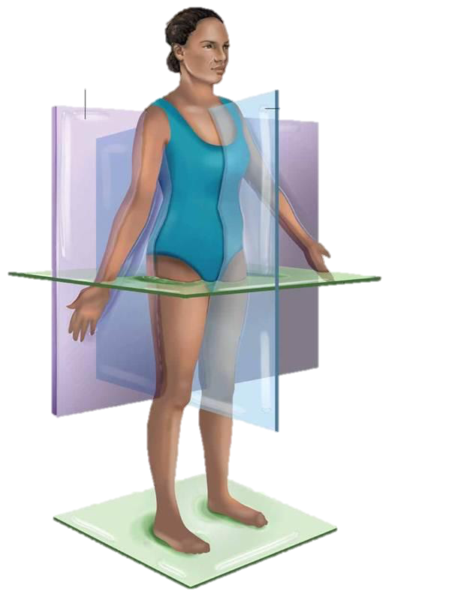
Classic Theories
Egocentric Direction Hypothesis
  Simon Rushton et al. (1998)
Mid-body axis
or z axis
Coronal Plane
Median Plane
y axis
x axis
Horizontal Plane
Notes:
In contrast, another theory states that we use the visual direction of the target relative to the body, ITS “EGOCENTRIC DIRECTION”, to walk towards the target. Which means that you just walk to the direction of the target. In other words, it suggests that we walk while pointing our straight-ahead (here indicated by the x-axis) to the target.

Slide 9

Normally ...
Notes:
However, normally, the two theories are redundant and predict the same behavior. As shown in this video, the walker walks to the fountain straight ahead, the optic flow and the perceived direction of visual target is overlapping. It’s hard to know which strategy he’s using, optic flow or egocentric direction, to guide his walking.
For video see https://cardiff.cloud.panopto.eu/Panopto/Pages/Viewer.aspx?id=791cdf7b-4dbd-465d-8a67-aa4d00a7a786

Slide 10
Challenge 1: how to disassociate optic flow and direction cues?
Notes:
So the first challenge is to

Slide 11
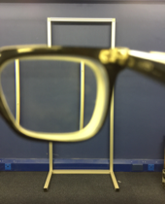
Displaced by Prisms
Notes:
One method is to set a mismatch between the real direction and perceived direction of the target. This can be done by displacing prisms. In this picture, the metal frame is actually in front straight ahead, but seen through the prism, the frame appeared to be shifted leftwards.

Slide 12
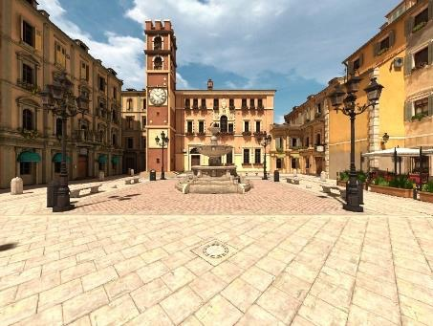
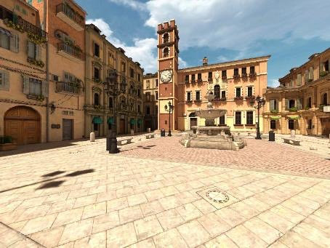
With Prisms …
Notes:
So in this example, by adding a prism, the whole view including the target can be rotated for a certain degree. Wearing the prism, the walker will misperceive the target, in this case, to the right of its actual position.

Slide 13

First step
Notes:
When he or she starts walking, HE OR SHE ACTUALLY MOVES IN A DIRECTION LIKE THIS.
In the first step, as there is no motion, the walker will first turn his body to face the image of the target and start walking. He thinks he walks to the visual target but actually he walks in the direction of his real straight ahead as shown by the red arrow.

Slide 14
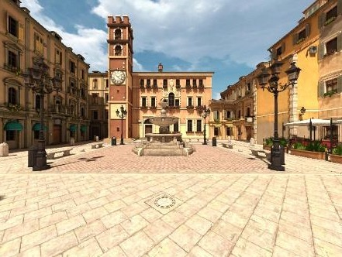
Walking using optic flow
Notes:
Once he starts walking, there will be optic flow. As you can see the FOE is not aligned with the target when he made the first step. In the following steps, if he uses optic flow, he will place the focus on the target [click],

Slide 15
Walking using optic flow
Notes:
and walk in a path like this.
What about using egocentric direction? Let’s go back to the beginning
For video see https://cardiff.cloud.panopto.eu/Panopto/Pages/Viewer.aspx?id=791cdf7b-4dbd-465d-8a67-aa4d00a7a786

Slide 16
With Prisms …
Notes:
The scene is shifted by the prism

Slide 17
First step
Notes:
The walker faces to the visual target as shown by the blue arrow, but actually moves in the direction referred by the red arrow in the real world.

Slide 18
First step
Notes:
And makes the first step

Slide 19
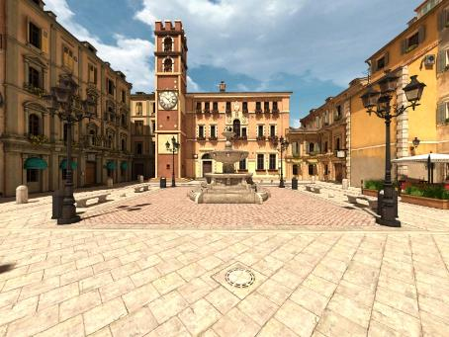
Walking using Direction
Notes:
THEN REALIGN his BODY WITH THE TARGET AND TAKE ANOTHER STEP

Slide 20
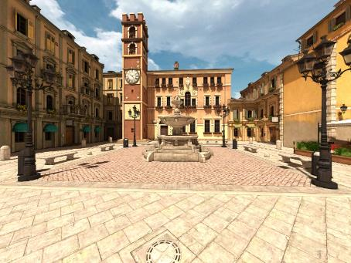
Walking using Direction
Notes:
AND DO THE SAME AGAIN [this really jumps too much to the right – the trajectory has changed between this and the prev slide – hopefully nobody will notice if you go through the slides quickly]

Slide 21
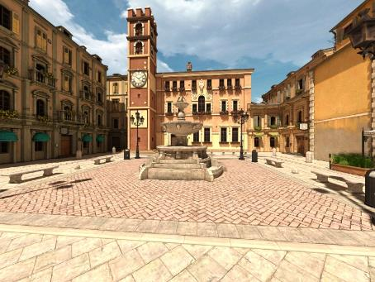
Walking using Direction
Notes:
AND DO THE SAME AGAIN [this really jumps too much to the right – the trajectory has changed between this and the prev slide – hopefully nobody will notice if you go through the slides quickly]

Slide 22
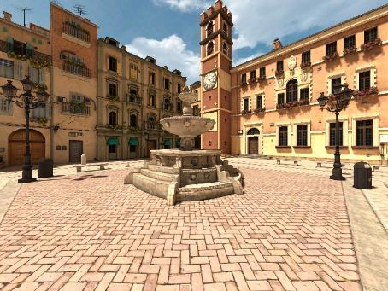
Walking using Direction
Notes:
AND AGAIN

Slide 23
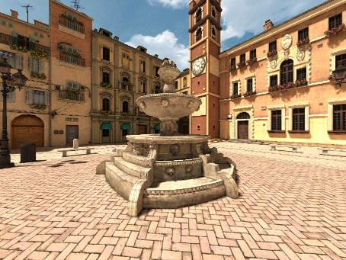
Walking using Direction
Notes:
AND AGAIN

Slide 24
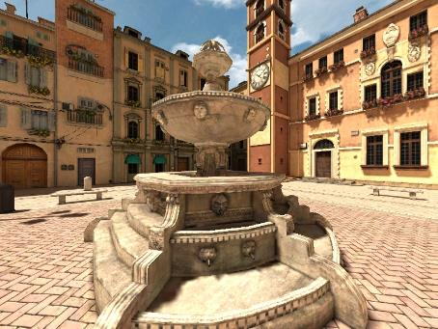
Walking using Direction
Notes:
AND END UP TAKING A CURVING TRAJECTORY LIKE THIS

Slide 25


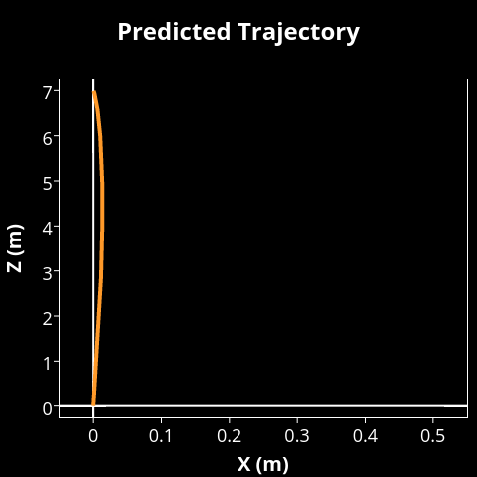


































































































Egocentric direction
$$+$$
Optic
flow
Notes:
Studies have found that direction is the primary cue (i.e., always has a role), some suggest that optic flow has a secondary role, supplementing direction,
When the flow becomes increasingly rich, its role increases and the trajectory will get straighter and straighter.

Slide 26



100%
Direction
66%
33%
0%
Notes:
Therefore, the weighting of the two cues could be inferred from the curvature of the paths taken to a target.

Slide 27
Other cues?
Notes:
So far, people looking at real walking have been concentrated on these two cues. My research question is: whether other cues play a role in the guidance of walking?

Slide 28
Notes:
let’s have a look at the example above. In envrionments rich in optic flow, there also seems to be plenty of spatial information which indicates the current position of the walker. For example, from this …

Slide 29
Notes:
To this, you can have a clear sense of where you are. You can see that you are not on a straight path to the target as you expected and make adjustments. So using position information, you can also steer a relatively straight path to the target.

Slide 30
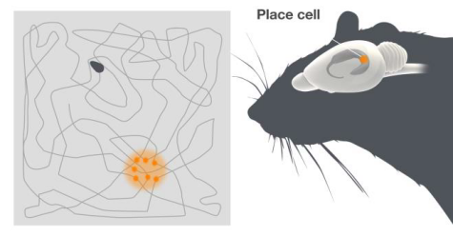
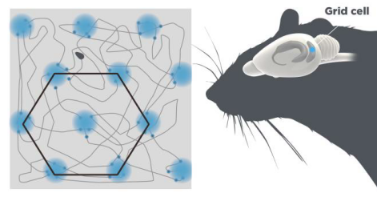
© The Nobel Assembly at Karolinska Institutet Source: https://www.nobelprize.org/
Notes:
Indeed, studies on rats have shown that cells in the brain code the position of the animal when it freely moves in an environment, called place cells and grid cells. The findings were awarded Nobel prize in 2014.

Slide 31
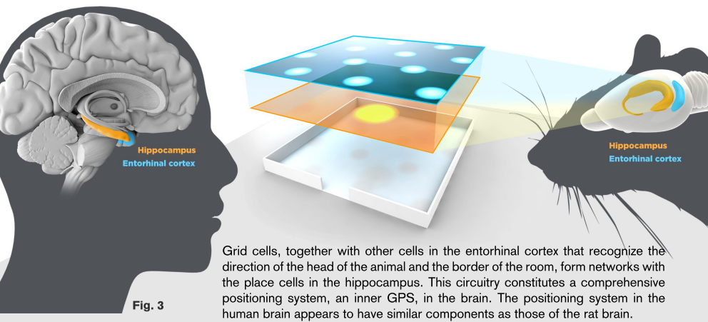
© The Nobel Assembly at Karolinska Institutet Source: https://www.nobelprize.org/
Notes:
Similar neural activities regarding position change have also been observed in human’s brain.

Slide 32
Egocentric direction
$$+$$
Optic
Flow and/or
Positional
cues
Notes:
Therefore, in addition to optic flow cues, it could be that when position cues become increasingly rich, and the trajectory will get straighter and straighter.

Slide 33
Notes:
However, again, optic flow and positional cues predict the same behaviour even while the person wear prism. In addition, as shown in this video, the two cues covary, that is, when there is rich optic flow information, usually there is also a plenty of spatial information about your current position.
For video see https://cardiff.cloud.panopto.eu/Panopto/Pages/Viewer.aspx?id=791cdf7b-4dbd-465d-8a67-aa4d00a7a786

Slide 34
Challenge 2: how we disassociate optic flow and positional cues?
Notes:
So now there is a second challenge: how to disassociate optic flow and positional cues. To solve this problem, one has to manipulate the visual information in the environment, to prevent optic flow and positional cues from covarying. It is difficult to do that in the real world, but with virtual environments, it is an easy task.

Slide 35

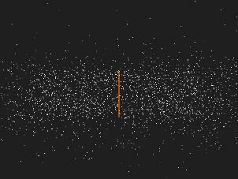
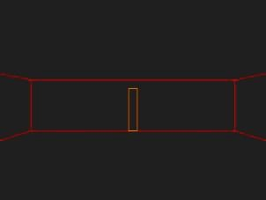
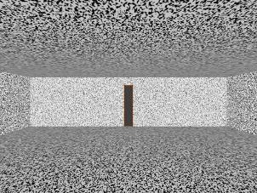
Virtual scenes
Notes:
In a key experiment of my PhD, I created four virtual environments with varying visual information. The simplest one is an empty space with only a post as the walking target. The most complex one is a room with random-noised wall paper. It has a doorway as the walking target. There were two median environments, one is a cloud of dots with the post target, and the other an outline or frames of the room.

Slide 36

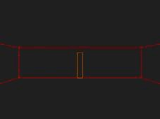
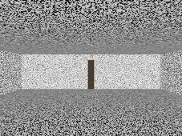
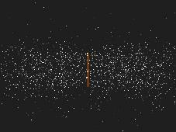
In terms of optic flow…
Notes:
As a consequence, we can sort the environment in an order like this in terms of optic flow. The line provides almost none, the outline very little, the room a lot and the dot cloud the most. The optic flow hypothesis predicts that the trajectories should become straighter in the scene with more optic flow.

Slide 37
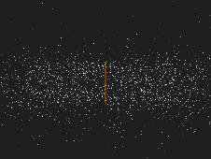
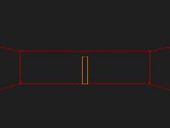
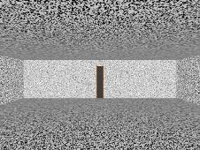
In terms of positional cues…
Notes:
As to the positional cues, again, the line provides almost none, but here the dot cloud provides little, then the outline a lot and the room the most. So a walker using these cues should walk in a straighter line along the blue arrow.

Slide 38
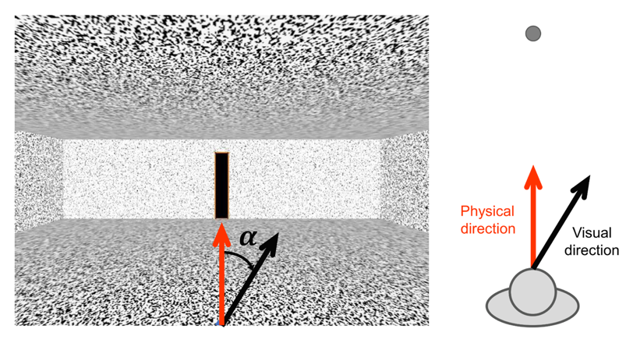
Prism in Virtual Reality
Notes:
To simulate the prism effect as shown earlier in virtual reality, we can CHANGE THE RELATIONSHIP BETWEEN SEEN DIRECTION AND MOVEMENT DIRECTION, by inserting an offset between the two directions, so that the participants thought they were walking along the red arrow but actually they walked along the black arrow.

Slide 39
Notes:
Here to show an example of the experiment. This is the dot cloud condition.
For video see https://cardiff.cloud.panopto.eu/Panopto/Pages/Viewer.aspx?id=791cdf7b-4dbd-465d-8a67-aa4d00a7a786

Slide 40
Notes:
This is the outline condition.
For video see https://cardiff.cloud.panopto.eu/Panopto/Pages/Viewer.aspx?id=791cdf7b-4dbd-465d-8a67-aa4d00a7a786

Slide 41




Results
Outline
Dot Cloud
Line
Empty Room
Notes:
This is what we found. Here let’s focus on the first trial of each condition. Recall that the optic flow predicts that the path should be the straightest in the dot cloud, and those in the outline and line should be similarly curved. However, what we found here is that, the path in the dot cloud is not straighter than in room. It’s not even as straight. In addition, we got straighter path in the outline than in the line condition. There is no difference in the path curvature between the outline and dot cloud condition. The findings suggest that, egocentric direction cues plus optic flow is not a whole story, and positional cues play a previously unrecognized role in the guidance of walking.
The participants walked four trials in each condition. So let’s look the data of the last trial. [click]

Slide 42
Study curiosity and exploration in VR
Notes:
After my PhD, I was involved in a project to develop a novel virtual reality paradigm to study curiosity and exploration and their effects on memory. An established paradigm to investigate this topic is to use trivia questions to invoke participants’ curiosity, for example, Which bird has eyes that are larger than its brain? It has been shown that the more curious that the participant felt about the trivia question, the better they could remember the question and its answer. However, it is unknown if we could observe similar effects when participants are allowed to explore an environment more actively.

Slide 43
VR in industry

Slide 44
Placement at Vicon
Notes:
To further extend my knowledge about virtual reality, I planned a placement in the industry during the ESRC post-doctoral fellowship, which is still going on now. It is in a company in Oxford, called Vicon.

Slide 45
About Vicon
The leading developer of motion capture and services
    The first commercial motion capture systems in the early 1980s.
    The most accurate real-time entertainment software in 2012.
    The world’s most intelligent camera platform in 2015.
Largest supplier in the world - has customers over 70 countries around the world
    Life sciences
    Entertainment
    Engineering industries
Notes:
In 1984, Vicon developed the first commercial motion capture systems, which was mainly used for clinical gait analysis.
In 1990s, there was a growing interest in motion capture in the rapidly developing entertainment industry. Vicon products were used in creation of Titanic in 1995 and the legendary ‘Ghosts’ MV by Michael Jackson in 1996. If you remember the dancing skeleton, it was Michael Jackson mocapped by Vicon system.
Life sciences – gait analysis and rehabilitation, posture, balance and motor control.
Engineering industries – object tracking, robots, even earthquake simulation.
Entertainment – games, widely used in filmmaking, including the king’s man (golden circle) Paddington bear and the recently released The Nutcracker and the Four Realms.

Slide 46
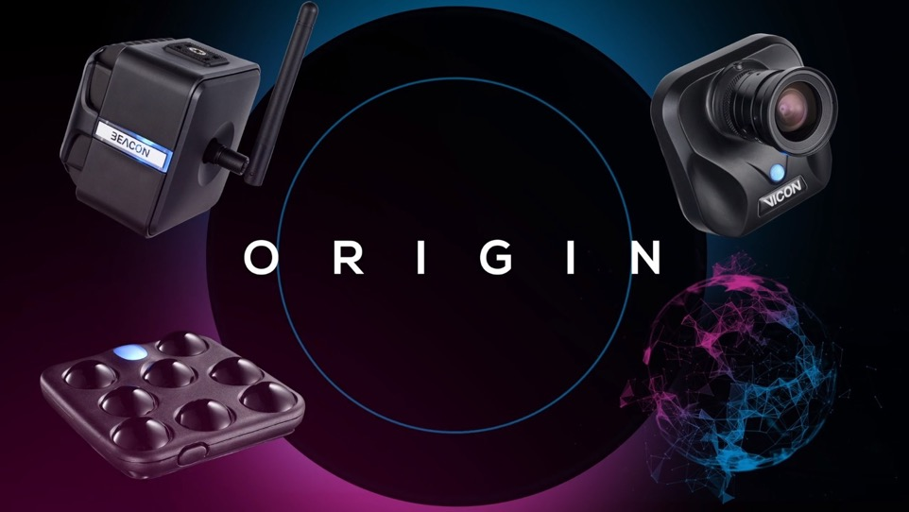
Notes:
Location Based VR products launched in 2018.
Viper – camera;
Pulsar – tracking clusters
Beacon – wireless network
Evoke – software platform

Slide 47
Notes:
Introduce how Origin works.
For video see https://cardiff.cloud.panopto.eu/Panopto/Pages/Viewer.aspx?id=791cdf7b-4dbd-465d-8a67-aa4d00a7a786

Slide 48
Placement at Vicon
Observe development of the systems.
Take part in a small project.
Notes:
During the placement at Vicon, I have the opportunity to observe the development of their VR systems - how new features are developed, how they solve problems in an engineering way and how knowledge about human perception and action could contribute to solving these problems. The development of virtual reality systems can be tightly related to the research on perception and action – actually they simulate the circle between what you feel (seeing, hearing etc.) and how you act or move (walking, reaching). I talked to people in Vicon, they showed great interest in what researchers have known about how people perceive and act, useful for creating smoother and more user-friendly products. I also have the opportunity to work with the development team a small project to solve a problem using my knowledge and skills gained from research on human perception. It has been an enjoyable expeprience.

Slide 49
VR in Research and Industry
Industry
Research
Notes:
Reciprocal relationship
Development of low-latency and high-precision systems can stimulate development of Innovative experimental applications, novel paradigms, and new research questions, for example to study interaction between humans, as well as between humans and the surrounding environments.
Reciprocally, advance in our knowledge about human perception and action, can help improve VR systems.
Relationship between Industry and research can be mutual beneficial.

Slide 50




Thank you!

