Slide 1
Exploring the Potential of Visual and Creative Techniques for Engaging Diverse Audiences and Increasing Research Impact
Collaboration, Engagement and Impact in Social Science Research: Approaches, Challenges and Benefits
ESRC Wales DTP and Cardiff University ESRC Impact Acceleration Account.
Friday 15th March 2019
Dawn Mannay mannaydi@cardiff.ac.uk
@dawnmannay

Slide 2
outline
Research cultures and practices
Dissemination and impact
Beyond the academic article
Case study
Summary

Slide 3


Research – what for?

Slide 4
Choice and restraint
‘There is no best way to tell a story about society… instead of ideal ways to do it the world gives us possibilities among which we chose’ (Becker 2007, p. 285)
But ideas of ‘choice’ are situated in relation to particular circumstances, wider systems and values, so that our decisions become framed as ‘obligatory choices’ (Bennett et al. 2009)

Slide 5
cultural technologies of intellectual activity
External market contingencies continue to stress the business case for research output (Mannay and Morgan 2014)
‘Publish or perish’ has become a harsh reality for researchers
But the majority of academic journal publications are uncited and underused
‘the regimes of control that surround contemporary approaches to publishing are choking creativity and, with it, the profession itself’ (Vale and Karataglidis 2016)

Slide 6
Standard Process
Writing up of the findings and recommendations in a final report
Restricted to a ‘small audience who are closely associated with the research project’ (Timmins 2015, p. 35)
Peer reviewed journal articles and other scholarly publications
Audiencing restricted to academia (Barnes at al. 2003)
Narrowness of dissemination strategy
Implications of research studies often have little impact on practice, policy or communities, limiting opportunities for change and improvement (Finfgeld 2003; Troman 2001)

Slide 7

Impact case studies
Much academic dissemination is positioned as passive and designed to accrue the most significant benefits to the researcher, rather than engendering wider value (Groundwater-Smith et al., 2015)
But growing emphasis on research impact
Research Excellence Framework (REF) in the UK
Impact - ‘any effect on, change or benefit to the economy, society, culture, public policy or services, health, the environment or quality of life, beyond academia’ (REF 2011)
Political, heath, environmental, legal, technological, economic, cultural and societal
Measurable impacts

Slide 8
More measurement?
This imperative for impact can be seen as another pressure for researchers
Increasingly subject to a range of administrative processes that demand that we can demonstrate that the research that we carry out, and the outputs that result from it, possess some utility to non-academics and that they possess causal powers to influence the world in some way or another’ (Knowles and Burrows, 2014: 242)
Pressure on academic staff, contributing to an audit culture where researchers are already continually measured and evaluated
Bur research, done well, is worth disseminating so maybe REF can provide opportunities for dissemination beyond the standardised and often inaccessible?

Slide 9

Enabling ethical engagement, impact and change?
Reports, books, journal articles
Informing policy
Academic conferences
How much impact do they have? Can they negotiate change?
What other options do we have?
What are the issues of ethics, representation, time immemorial (Brady and Brown 2013), voice and visibility?
What opportunities can be gained from the impact agenda?

Slide 10
Moving Beyond the Academic Article
Useful to consider the ways in which creative narrative forms can replace visual images and detailed, identifying, biographical accounts, yet still retain impact; and ethically, yet powerfully, communicate the stories that participants have shared in the research process (Mannay 2016)
Imaginative ways of reporting can communicate research findings to a wider public and different forms reach different audiences (Silver, 2016)
Therefore, it is important to consider how researchers can mediate ‘vigorous research through a creative format to increase impact’ (Mannay, 2013, p.134)
Some examples…

Slide 11

Poetry and letters
Katherine Carroll
Representation of the intimate thoughts, affective sentiments, and labours that surround the provision and use of donor milk
Dawn Mannay
Exploring places of safety and danger in violent and abusive relationships
But still within the academic article

Slide 12
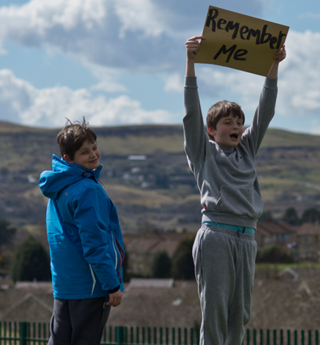
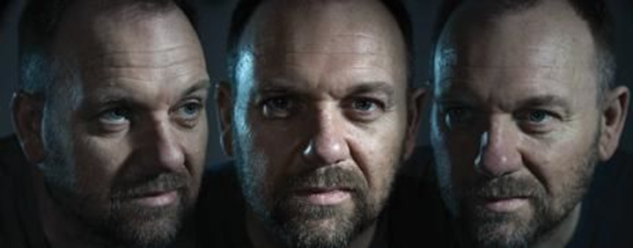
Theatre As a safe space
Under Us All – Michael Richardson
The People’s Platform Project – Eva Elliot, Ellie Byrne, Gareth Williams
Moved dissemination ‘beyond the confines of the ‘Ivory Tower’, outside the bounded walls of words in books and texts—and through spoken word and performance

Slide 13
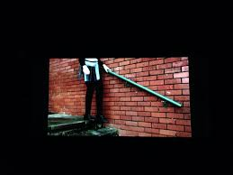
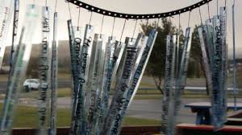
D(art)a
Emma Renold
School-based participatory activist project with young people
Range of collaborative art pieces to represent girls’ experiences of oppressive sexual cultures and practices
Local galleries, commissioned films, school assemblies

Slide 14
CASE STUDY
The Children's Social Care Research and Development Centre (CASCADE) undertook an in depth qualitative study into the educational experiences and opinions, attainment, achievement and aspirations of children and young people who are looked after in Wales commissioned by the Welsh Government.
Objective 1: Conduct an in depth qualitative research study with looked after children and young people, to provide insight into their experience of education and their opinions on what could be done to improve it
Objective 2: Collate and report relevant literature and data
Project Partners – The Fostering Network, Voices from Care Cymru, Spice Innovate
Music and Art Extension Project – Ministry of Life, Like an Egg

Slide 15
methods
Statistical and literature review **
Systematic review **
Creative methods and interviews
Peer researcher led focus groups

Slide 16

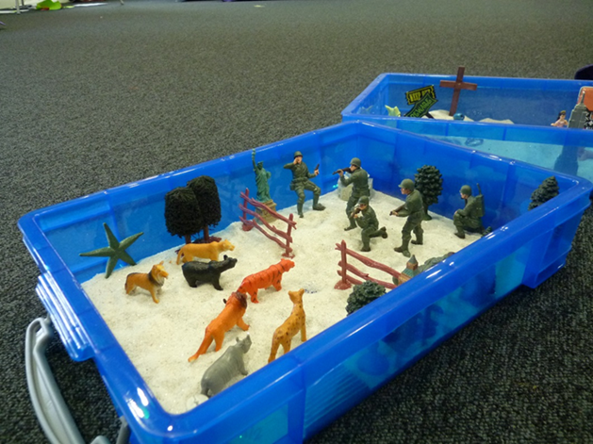
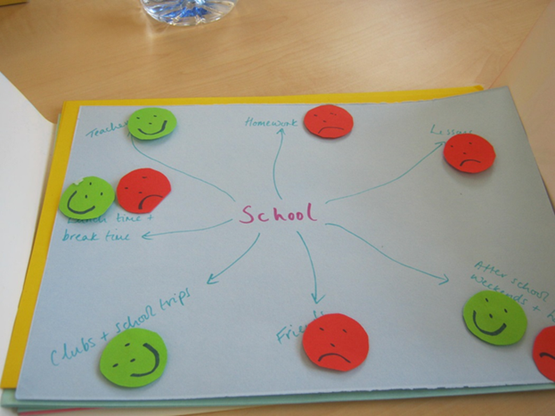
Creative all day workshops – Peer Led Focus Groups

Slide 17
Why creative participatory methods?
Moving away from the ‘social work interview’
Empowering young people to lead and direct the conversations (Lomax et al. 2011)
Peer led (Lushey and Monroe 2014)
Fighting familiarity and encouraging defamilairisation (Mannay 2010, 2013)

Slide 18


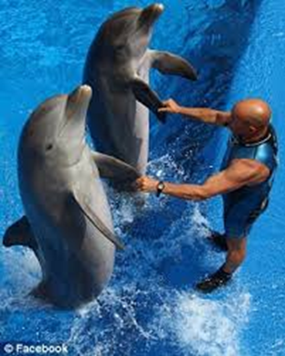
Aspirations
Children and young people did not lack aspiration
“I want to be an architect … because I like art and most of my family are builders” (Male, age 12)
They often had altruistic aspirations and wanted to help others
“I want to work with kids in care when I’m older because I know what it’s like and I’ve been through it most of my life. So I can actually be one of those people who turn around and say ‘I understand’, and actually do understand” (Female, 16+ group)

Slide 19
Experiences – being ‘different’
‘Being made to feel like an outcast because I was in care… that made me feel alienated, frustrated, lonely and vulnerable’. (Male participant, 16+ group)
‘We don’t want people to be ‘looked after’, you want to be a normal kid too you know because it’s only one, its only label of you’ (Female participant, 16+ group)
‘I hate people feeling pity for me. I’m just a normal child, like…I’m in foster care, it doesn’t mean you’re just like some pity child’ (Male participant, 16+ group)

Slide 20
Experiences – being visible
‘I don’t know bad bit was like the LAC Reviews and whatever because the teachers kind of knew that you were in care and whatever and that, they all were, people would be like, ‘oh why are you are going with Miss So-and-so?’ (Nadine, age 21)
‘I just didn’t want it, I was like I don’t need that, it’s singling me out and its making me seem special when I’m not, I’m a normal person’. (Female participant, 16+ group)
‘Any meetings, if they are necessary, should be held outside of school time, not just at a time that is convenient for the professionals’. (Female participant, 16+ group)

Slide 21
Experiences - conflict
If you’re moved out of county then one county will argue with the other county about who pays for transport, who pays for the schooling, who pays for food, who pays for everything that has something to do with your education’ (Male Participant, 16+ group)
‘Councils are just like: ‘no that’s your problem, no that’s your problem, palming young people off sort of thing and it’s just really unpleasant’ (Male participant, 16+ group)
‘You know it shouldn’t have to be, ‘oh you’re paying for it, you’re paying for it’, you know? It’s a child, it’s a human being’ (Male participant, 16+ group)

Slide 22
‘Let off’ or ‘let down’
‘As soon as I went into care, then went back to school and my teachers majority of them treated me completely different, because I was in care they moved me down sets, they put me in special help, they gave me – put me in support groups. And I was just like I don’t need all this (Female, 16+ group)
It’s about motivation. All you need is a good kick up the arse. And I think if somebody had given that to me when I was 16 or 17, I would probably have been like ‘right, that’s it I want to, I’m going to do something with my life’ (Male participant, 16+ group).
Unintended consequences –position of leniency was often well-intentioned, based on what is known about children and young people who are looked after and the difficulties they face.
But - teachers who they talked about as being best were those who encouraged them back into lessons/school, and pushed them academically, rather than allowing them to disengage with school work simply because of their ‘looked after’ status

Slide 23


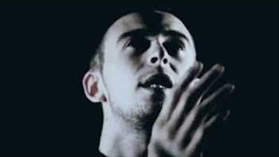
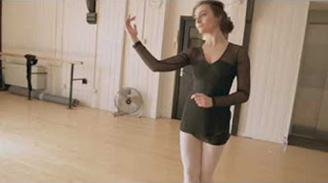
Reframing and revisualising data
Short films
Songs and music videos
Posters and postcards
Thrive magazine
#messagestoschools
Practitioner Workshops
Teaching Sessions
ExChange: Care and Education
Available at: http://www.exchangewales.org/laceproject

Slide 24
Outcomes and impacts
Attempted to counter the criticism that research findings have little impact on communities outside of academia
Difficult to recreate the tone, emphasis and depth of meaning from the original accounts, and this was not always achieved, nevertheless, the central messages of the accounts were retained
Practitioner feedback - ‘reinforced the need to provide a voice for the child - give them choices. Listen actively, support, believe in them and push them to meet their potential’; ‘implement this in my everyday work’; ‘ensure all appointments for young people take place outside of their education’
Potential for the research recommendations to translate into changes on the ground

Slide 25



SUMMARY - Q&A

Slide 26
References
Becker, H. S. 2007. Telling about society. Chicago: University of Chicago Press.
Bennett, T., M. Savage, E. Silva, A. Warde, M. Gayo-Cal, and D. Wright. 2009. Culture, class, distinction. Abingdon: Routledge.
Carroll, K. 2015. Representing Ethnographic Data through the Epistolary Form: A Correspondence between a Breastmilk Donor and Recipient. Qualitative Inquiry ifirst edition http://qix.sagepub.com/content/early/2015/02/21/1077800414566691.full.pdf+html
Finfgeld, D. 2003. Metasynthesis: The state of the art—so far. Qualitative Health Research, 13, 7, pp. 893-904.
Lushey and Monroe, R. 2014 Participatory peer research methodology: An effective method for obtaining young people’s perspectives on transitions from care to adulthood, Qualitative Social Work, doi:(10.1177/1473325014559282).
Lomax, H., Fink, J., Singh, N. & High, C. 2011. The politics of performance: Methodological challenges of researching children’s experiences of childhood through the lens of participatory video, International Journal of Social Research Methodology, 14(3), 231–243.
McLeod, A. 2007. Whose agenda? Issues of power and relationship when listening to looked-after young people. Child and Family Social Work, 12, 3, pp. 278-286.
Mannay, D. 2010. Making the familiar strange: Can visual research methods render the familiar setting more perceptible?. Qualitative Research 10(1), pp. 91-111.
Mannay, D. 2016. Visual, narrative and creative research methods: application, reflection and ethics. London: Routledge.
Mannay, D., Evans, R., Staples, E., Hallett, S., Roberts, L., Rees, A., and Andrews, D. 2017. ‘The Consequences of Being Labelled ‘Looked-After’: Exploring the Educational Experiences of Looked-after Children and Young People in Wales’, British Journal of Educational Research 43(4), pp. 683-699.
Mannay, D. and Morgan, M. 2015. Doing ethnography or applying a qualitative technique?: Reflections from the 'waiting field'. Qualitative Research 15(2), pp. 166-182.
Mannay, D., Staples, E. and Edwards, V. 2017. Visual methodologies, sand and psychoanalysis: employing creative participatory techniques to explore the educational experiences of mature students and children in care. Visual Studies 32(4), pp. 345-358.
Mannay, D.et al. 2018. Enabling talk and reframing messages: Working creatively with care experienced children and young people to recount and re-represent their everyday experiences. Child Care in Practice
Renold, E. 2017 Feel what I feel: Making da(r)ta with teen girls for creative activisms on how sexual violence matters. Journal of Gender Studies, 27, pp. 37-55.
Richardson, Michael J. 2015. Theatre as safe space? Performing intergenerational narratives with men of Irish descent. Social & Cultural Geography, 16(6), pp. 615-633.
Troman, G. 2001. Tales from the interface: Disseminating ethnography for policy making. In G. Walford (ed.), Ethnography and Education Policy. London: JAI, pp.251-273.
Vale, P. and Karataglidis, S. 2016. Pressure to publish is choking the academic profession https://theconversation.com/pressure-to-publish-is-choking-the-academic-profession-62060

